Slide 1
Chapter 1
An introduction to relational databases and SQL
and Continue…

Slide 2
SQL is…
Structured Query Language
Acronym: SQL, and pronounced as “Sequel” OR “S-Q-L”
Originally developed by IBM in 1970s
Designed to support E.F Codd's Relational model
The term SQL. The S, for Structured, and the L, for Language, Q, stands for "Query," which--if taken literally--would restrict you to asking the database questions.
But SQL does much more than ask questions. With SQL you can also create tables, add data, delete data, splice data together, trigger actions based on changes to the database, and store your queries within your program or database.
Today almost all RDBMS(MySql, Oracle, Infomix, Sybase, MS Access) uses SQL as the standard database language.
SQL is used to perform all type of data operations in RDBMS

Slide 3
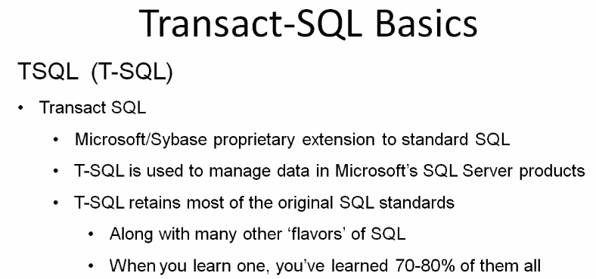

What is T-SQL

Slide 4
Categories of T-SQL statements OR DBMS Language SQL is DQL, DML, DDL, DCL, TCL
Data Query Language (DQL)
Data Manipulation Language (DML)
Data Definition Language (DDL)
Data Control Language (DCL)
Transaction Control Language (TCL)
Statements for retrieving records from one or more tables
SELECT
Statements for querying and modifying data
INSERT, UPDATE, DELETE, MERGE
Statements for object definitions
CREATE, ALTER, DROP, TRUNCATE
Statements to grant and take back authority
GRANT, REVOKE
Statements for managing transactions in the DB
COMMIT, ROLLBACK, SAVEPOINT
Notes:
Course 10774A
Module 3: Introduction to T-SQL Querying

Slide 5
DQL : Data Query Language
DQL is used to fetch data from the database using select statement.
Command | Description
select | retrieve records from one or more table

Slide 6
DML : Data Manipulation Language
DML commands are used for manipulating the data stored in the table and not the table itself.
DML commands are not auto-committed. It means changes are not permanent to database, they can be rolled back.
Command | Description
insert | Storing/Inserting a new row in a table
update | Update/modified existing data
delete | to delete a row
merge | merging two rows or two tables

Slide 7
DDL : Data Definition Language
DDL This includes changes to the structure of the table
DDL commands are auto-committed. That means it saves all the changes permanently in the database
Command | Description
create | Create Objects: ( Database, Tables, Views, Stored procedures, …etc)
alter | There are various uses of alter command, such as, to add a column to existing table to change datatype of any column or to modify its size. alter is also used to drop a column.
truncate | remove all data from the table and leave or keep the table structure
drop | remove the table from the database

Slide 8
DCL : Data Control Language
DCL provides command to grant and take back authority.
Command | Description
grant | grant permission of right
revoke | take back permission.

Slide 9
TCL : Transaction Control Language
TCL are used to manage the changes made by DML statements. These commands can annul changes made by other commands by rolling back to original state. It can also make changes permanent.
Command | Description
commit | to permanently save
rollback | to undo change
savepoint | to save temporarily

Slide 10
Differences between Delete, Drop, and Truncate:
Delete: delete rows out of the table – (Can be undo)
Truncate: remove all data from the table and leave or keep the table structure – (Can not undo)
Drop: remove the table from the database – (Can not Undo)

Slide 11
Order of execution:
The order in which a query is written is not the order in which it is evaluated by SQL Server.
5: SELECT Column1, Column2, Aggregate function
1: FROM Table_Name
2: WHERE predicates or search condition
3: GROUP BY Column1, Column2
4: HAVING Aggregate function Condition
6: ORDER BY Column ASC / DESC

Slide 12
Applying the logical order of operations to writing SELECT statements
SELECT SalesPersonID, YEAR(OrderDate) AS OrderYear
FROM Sales.SalesOrderHeader
WHERE CustomerID = 29974
GROUP BY SalesPersonID, YEAR(OrderDate)
HAVING COUNT(*) > 1
ORDER BY SalesPersonID, OrderYear;

Slide 13
Basic SELECT Statements

Slide 14
Elements of the SELECT statement
Clause | Expression
SELECT | <select list>
FROM | <table source>
WHERE | <search condition>
GROUP BY | <group by list>
ORDER BY | <order by list>

Slide 15
Retrieving columns from a table or view
Use SELECT with column list to display columns
Use FROM to specify a source table or view
Specify both schema and table names
End all statements with a semicolon – Optional
Keyword | Expression
SELECT | <select list>
FROM | <table source>
SELECT CustomerID, StoreID
FROM Sales.Customer;

Slide 16
Using calculations in the SELECT clause
Calculations are scalar, returning one value per row
Using scalar expressions in the SELECT clause
Operator | Description
+ | Add or concatenate
- | Subtract
* | Multiply
/ | Divide
% | Modulo
What’s this new column header name will be?
SELECT unitprice, OrderQty, (unitprice * OrderQty)
FROM sales.salesorderdetail;

Slide 17
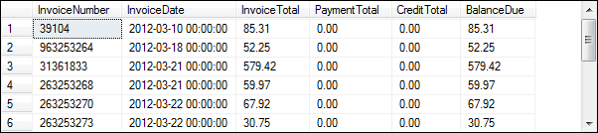
A SELECT statement that retrieves and sorts selected columns and rows:
SELECT InvoiceNumber, InvoiceDate, InvoiceTotal, PaymentTotal, CreditTotal,
InvoiceTotal – PaymentTotal – CreditTotal AS BalanceDue
FROM Invoices
WHERE InvoiceTotal – PaymentTotal – CreditTotal > 0
ORDER BY InvoiceDate;
The output result set:

Slide 18
Basic DDL Syntax

Slide 19
Some DDL Syntax example
Create table Syntax:
CREATE TABLE table_name ( column_name1 data_type(size), column_name2 data_type(size), column_name3 data_type(size), .... );
Creates a new database Syntax:
CREATE DATABASE AP;
Create Index Syntax:
CREATE INDEX index_name ON table_name (column_name)

Slide 20
CREATE VIEW Syntax
CREATE VIEW view_name AS SELECT column_name(s) FROM table_name WHERE condition
Example:
CREATE VIEW [Products Above Average Price] AS SELECT ProductName,UnitPrice FROM Products WHERE UnitPrice>(SELECT AVG(UnitPrice) FROM Products)

Slide 21
CREATE Stored Procedures Syntax
CREATE Procedure sp_Procedure_name AS SELECT column_name(s) FROM table_name WHERE condition
ORDER BY ccolumn_Name
Example:
A CREATE PROCEDURE statement for a procedure named spVendorsByState
CREATE PROCEDURE spVendorsByState @State char(2) AS SELECT VendorName, VendorState, VendorPhone FROM Vendors WHERE VendorState = @State ORDER BY VendorName;

Slide 22
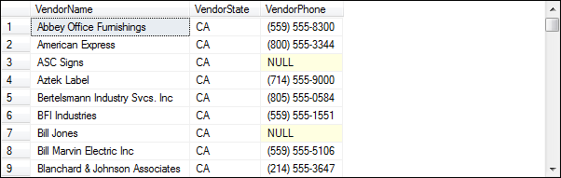
A statement that executes the spVendorsByState stored procedure
EXEC spVendorsByState 'CA';
The result set

Slide 23
DDL, Continue
ALTER TABLE Statement Syntax
ALTER TABLE table_name ADD column_name datatype
To delete a column in a table syntax:
ALTER TABLE table_name DROP COLUMN column_name

Slide 24
Basic DML Syntax

Slide 25
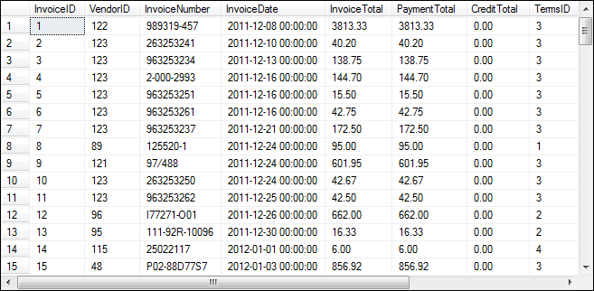
Sample of an Invoice table

Slide 26
INSERT INTO Syntax
INSERT INTO table_name VALUES (value1,value2,value3,...);
Add a row to the Invoices table
INSERT INTO Invoices (VendorID, InvoiceNumber, InvoiceDate,
InvoiceTotal, TermsID, InvoiceDueDate)
VALUES (12, '3289175', '4/18/2012', 165, 3, '5/18/2012');

Slide 27
UPDATE Syntax
UPDATE table_name SET column1=value1,column2=value2,... WHERE column=some_value;
Change the value of a column for a selected row
UPDATE Invoices
SET CreditTotal = 35.89
WHERE InvoiceNumber = '367447';

Slide 28
DELETE Syntax
DELETE FROM table_name WHERE some_column=some_value;
Delete a selected invoice from the Invoices table
DELETE FROM Invoices
WHERE InvoiceNumber = '4-342-8069';

Slide 29
Overview of Joins

Slide 30
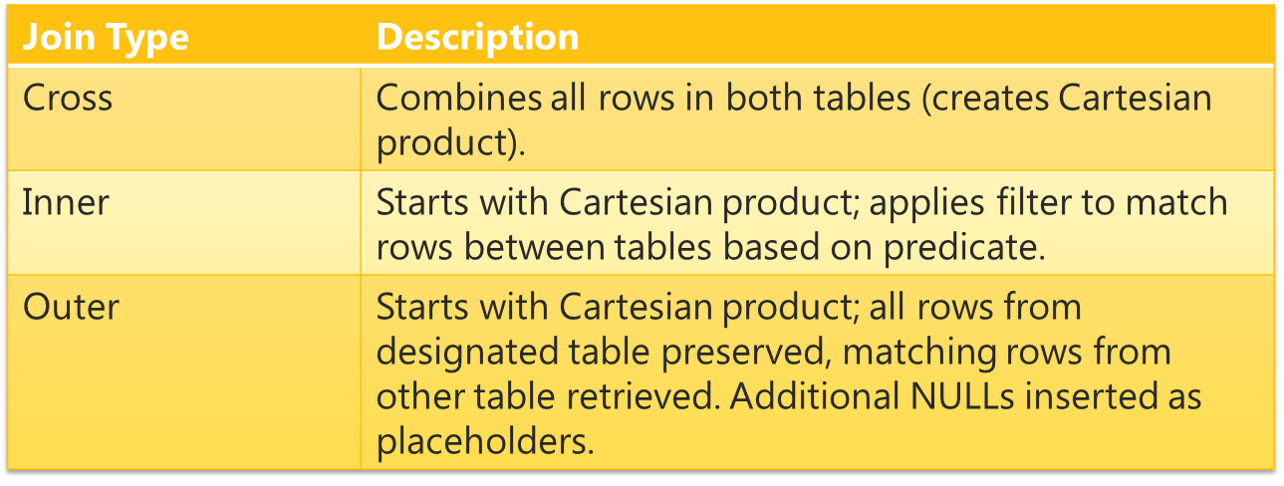
Join Types:
Joining the table is a way of combining data from tables based on a fields they share.
Joins are always made on specific field or fields
Demo the excel join.

Slide 31
Outer Join
An Outer join brings in all names listed in all tables and it fills NULLS wherever there isn’t information for giving column for that row

Slide 32
Left outer Join
Left join brings in all the information from the table on the left SIBLING and any matching rows from the table on the right - EYE COLOR for rows with the same name.
If name in the sibling table is not present in the eye color table you get NULL as in Shannon and Tracy

Slide 33
Right outer Join
It’s the reverse, will get all the rows form the right table Eye color and the matching rows from the left table Sibling
As you can see, the output list of names varies between the Left and the Right joins because we changing which tables comes first.
Shannon and Tracy do not exist in the eye color table so they show up in the left join only
Morgan do not exist in the Sibling table so she only shows up in the right join

Slide 34
Inner Join
An Inner join preserves only the rows that have the same key fields; and in our case “Name” between those tables
We only get information for names that are listed in both tables and there are no NULLs

Slide 35
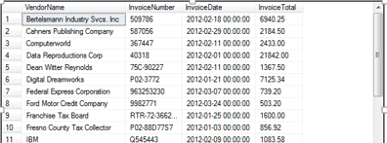
INNER JOIN Syntax:
SELECT column_name(s) FROM table1 INNER JOIN table2 ON table1.column_name=table2.column_name;
Example: A SELECT statement that joins data from the Vendors and Invoices tables
SELECT VendorName, InvoiceNumber, InvoiceDate, InvoiceTotal
FROM Vendors
INNER JOIN Invoices
ON Vendors.VendorID = Invoices.VendorID
WHERE InvoiceTotal >= 500
ORDER BY VendorName, InvoiceTotal DESC;

Slide 36
Assignment.
Please write a small document illustrating your understanding to different types of joins.

Slide 37
T-SQL language elements: comments
Marks T-SQL code as a comment:
For a block, enclose it between /* and */ characters
T-SQL Editors such as SSMS will typically color-code comments, as shown above
For inline text, precede the comments with --
/*
This is a block
of commented code
*/
-- This line of text will be ignored

Slide 38
A SELECT statement with a block comment
/* Author: Bryan Syverson Date: 8/22/12 */ SELECT InvoiceNumber, InvoiceDate, InvoiceTotal, InvoiceTotal – PaymentTotal – CreditTotal AS BalanceDue FROM Invoices;
A SELECT statement with a single-line comment
SELECT InvoiceNumber, InvoiceDate, InvoiceTotal, InvoiceTotal – PaymentTotal – CreditTotal AS BalanceDue -- The fourth column calculates the balance due FROM Invoices;

